Slide 1

Safety Reporting Reference Model: Optimizing Global Safety Reporting in Clinical Trials using Local Laws

Slide 2
The presenter(s) for today’s educational program is/are:
Steven Beales
I have no relevant financial relationship(s) in connection with this educational activity.

Slide 3




Stressed About COVID-19? What Can Help
Keeping Safe
Staying Connected
Changing for the Better
Notes:
This is the best time for clinical research that I can remember. Everyone is looking to our industry for hope, economic well-being and to save lives. It is also the most stressful time. I can remember.
What has been helping you through the COVID-19 crisis? For me, it’s 3 ideals -
1) Keeping safe – including thinking about new ways to keep patients safe from harm as we rush to find treatments and vaccines for COVID-19.
2) Staying connected – We are a conservative industry who does what we know works until things fall apart. In times like these, we're forced to change and invent new ways to manage global trials.
3) Changing clinical trials for the better –
Today I’ll be sharing with you some of the most important ideas that have been discovered in Global Safety Reporting.
I’ll be introducing you to the Safety Reporting Reference Model and the AI that’s been used to operationalize it.

Slide 4






Safety Reporting Harmonization Working Group
Top 1 US Pharma
Top 1 EU Pharma
Top 2 Japan Pharma
Top 1 US IRB
Top 2 US CRO
Top 1 US Biotech
Notes:
Hi I’m Steven Beales, SVP of scientific and regulatory at WCG Clinical. We're going to enjoy the time we spend together this afternoon/morning/evening. I’ve spent the last 10 years building global safety reporting systems with some of he most brilliant companies in our industry.
I co-chair the Safety Reporting Harmonization Working Group with experts from the largest US, European and Japanese biopharmas, and the largest US CROs and IRBs.
Our mission is to -
1) Drive global harmonization in reporting rules for Regulatory Authorities, Investigators and Ethics Committees by creating a reference model of global safety reporting rules
2) Optimize the end to end process flows of safety reporting between Investigators, Sponsors, CROs, Competent Authorities, and ECs in our shared responsibility for patient safety.

Slide 5
What is the Function of Working Group?
Global Harmonization
Clear Rules
Defined Accountability
Consistent Application
Precision Distribution
Standardized Process
“Codified” Country Rules
Compound Level
Unburdened Resources
Sites/IRB/IECs
Study Teams
Monitors
Quality Oversight
Process and Procedures
Transparency & Monitoring
Compliance
Notes:
Our goal is to give you the opportunity to become heroines in your own organization. We’re sharing a proven approach that you can apply with confidence in your organization. Without this guide, it’s daunting to know where to start with assuring compliance between Drug Safety and Clinical Operations.
The 4 most important steps are
Global Harmonization –Understanding how we produce safety letters internally, controlling how we interpret country rules, defining our accountabilities and applying it consistently across all our studies.
Precision Distribution – Understanding that management of a compound's safety profile is not a study but a compound level accountability and to structure accordingly. Sites work with so many teams that managing it within a study subjects them to over distribution and fragmentation.
Unburdening Resources – Focusing on the roles who produce safety letters, those who receive safety letters and those accountable for site and study management and reduce the work they need to do.
Quality Oversight – Building in quality oversight activities to ensure the sustainability of the solution and ensure compliance by putting in controls on country rules and role-based training.

Slide 6

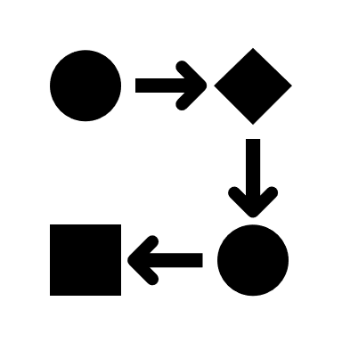

Global Safety Reporting Challenges
No Standards
Unclear Regulations
Conflicting Interpretations
Notes:
When we embarked on this journey 10 years ago, what were the main challenges in Global Safety Reporting that still exist today?
There are no existing global standards for distributing safety reports globally to investigators, ethics committees, and regulatory authorities.
Does each country still uniquely regulate when and how interested parties receive safety reports? – Yes and later when we catalogued the variations, we found over 40 different approaches.
Do biopharmas interpret local country rules themselves to decide what safety information should be distributed in each country? - Yes, every biopharma defines what safety reports they will generate and how they will aggregate that information.

Slide 7



Lack of Global Harmonization Consequences
Regulatory Repercussions
Fractured Accountability
Increased Costs
Notes:
As clinical research becomes more global, this lack of global harmonization has become the No.1 safety reporting problem for Sponsors.
Because rules and practices vary from country to country, Sponsors live in fear of regulatory repercussions and changing regulations, which has become the No.2 Safety Reporting problem for Sponsors.
It is difficult to understand in each country the role the Sponsor plays in coordination with the regulatory authority, the investigators, the ethics committees or safety committees in sharing patient safety responsibilities.

Slide 8



Safety Reporting Reference Model
125 Countries
7800 Country Rules
Quarterly Updates
Notes:
What is our suggested solution to the global harmonization problem?
We were pleased to release our first working group deliverable at end of last year - the safety reporting reference model version 1.0 for 125 countries and 63 different types of local rules.
We have catalogued all the variations in local laws that affect safety reporting and stored them in a rules database that can be used to power a safety reporting system.
The model contains over 7800 country rules and we managed to reduce every rule to a picklist of 3-5 options.
We will be publishing updates to this model every 6-12 months.

Slide 9
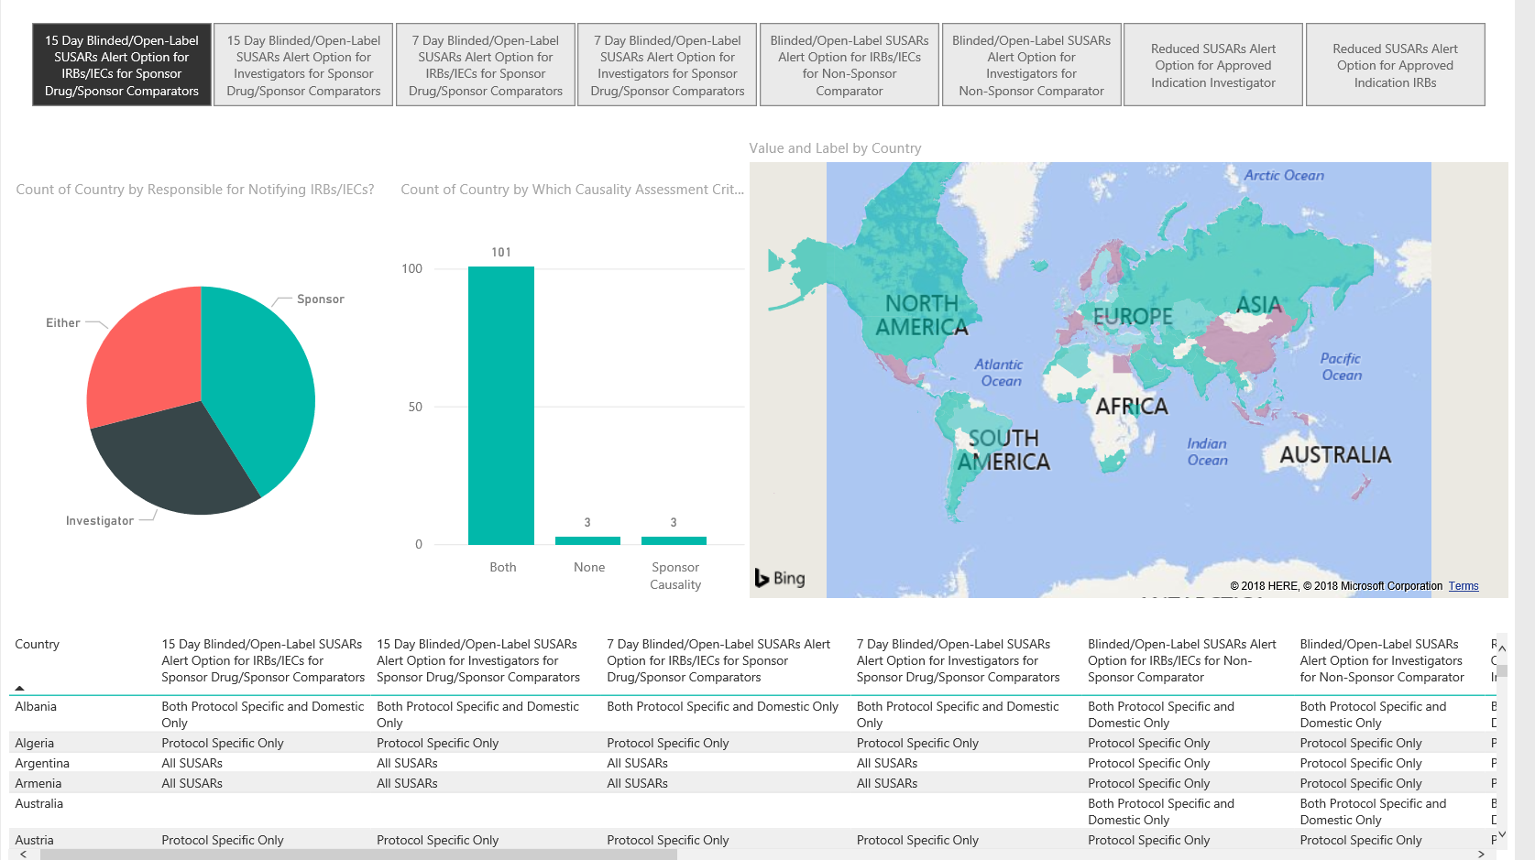
Global Expedited Reporting Rules
Notes:
As an example of the patterns we’ve found in our analysis, there are 5 different types of expedited reporting that occur in countries either
All SUSARs, No SUSARs, Domestic Only, Protocol Specific and Both Protocol Specific and Domestic Only.
36% of countries have some form of reduced expedited reporting.
If a sponsor sends SUSARs to all Sites and Ethics Committees, they are over-distributing by about 50% according to local laws.

Slide 10
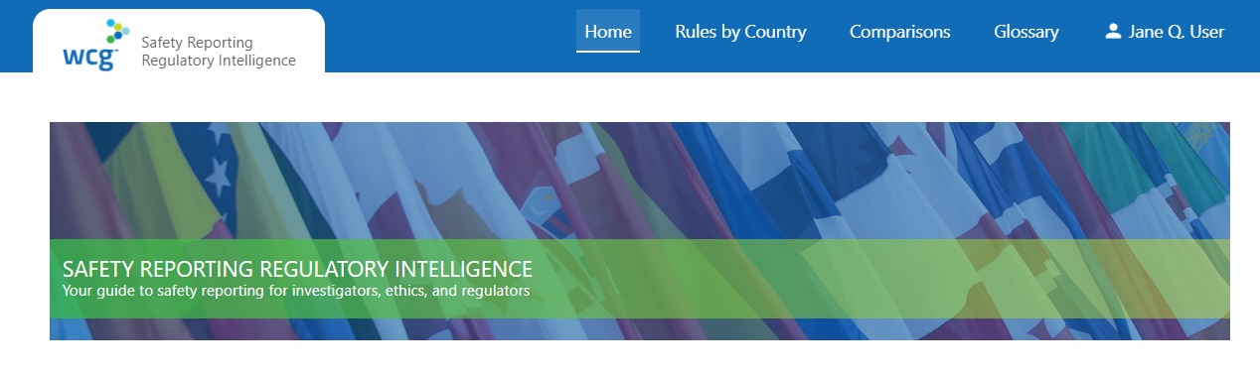
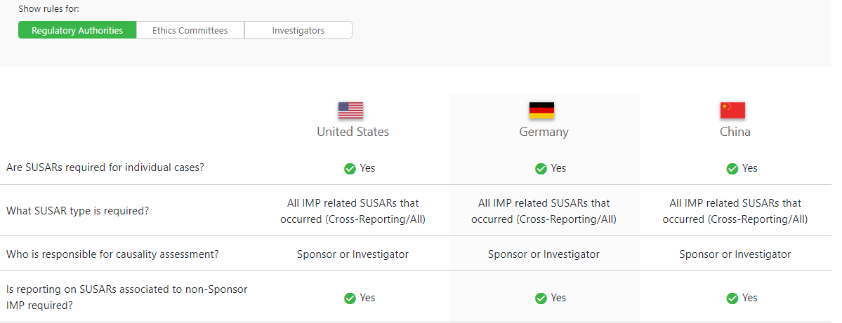
Safety Reporting Regulatory Intelligence
Safety Reporting
Regulatory Intelligence
Notes:
Safety Reporting Regulatory Intelligence - Made available in a portal managed by Working Group
The safety reporting reference model consists of
Safety Document Characteristics e.g. SUSARs, Reference Safety Information
Country Characteristics e.g. Unblinding requirements, Ethics Committee, Regulatory Authority and Investigator reporting requirements
Oversight and Procedures e.g. Translation of regulations into checklists and operational steps

Slide 11


Safety Reporting Reference Model – How is it Maintained?
Artificial Intelligence
Monitor Regulatory changes
Regulations, guidance and directives
Natural Language Processing
Text Summarization
Text Classification
SafetyPortal metrics and analytics
200 million records
Human Expertise
Harmonization Working Group
Changes in Interpretation of Rules
Safety Reporting Reference Model
Notes:
To maintain our model, we use Natural Language Processing to summarize and classify over 100 feeds of regulatory information.
The ability to extract the most important 6 lines as a summary from guidance has been invaluable in cutting the time to support this resource intensive activity by over 80%.
Building on work of the Aeolus project to match different safety and clinical terminology concepts and product names across countries is also essential to this effort.

Slide 12



Pressures on Clinical Trial Sites
Too Many Reports
Duplicate Reports
Overly Time-consuming
Too Many Websites
Useful Information Hidden
Notes:
How does the lack of precision distribution affect Sites?
Sites are overwhelmed with over-reported and cross-reported safety reports due to “brute-force” distribution.
Many companies still distribute all safety reports to all Sites and Ethics Committees due to a literal interpretation of GCP instead of observing local laws much to the frustration of sites, ethics committees and regulatory authorities.

Slide 13
Why do Sites get Too Many Reports?
More THAN 20 PER MONTH
AVERAGE PER QUARTER
REFUSED TO PROCESS
80%
170
20%
Number of Safety Reports
Number of Sites
Notes:
80% of sites receive more than 20 SUSARs per month.
20% have refused to process a SUSAR because it was an over-distribution – a Safety Report that did not qualify as an unanticipated problem and did not need to be submitted to the IRB.
The most common complaint from sites on our Safety Reporting site survey is - “Why can’t sponsors get their act together and stop sending us SUSARs where there is no causal relationship to the drug?”
The FDA estimated 86% of SUSARs on 1 oncology trial did not qualify for expedited reporting.
Average PI receives 170 safety letters per quarter. Median PI receives 85 per quarter.

Slide 14
What is Burden on Site Resources?
1
1
61% SITES > 80 hours/month staff time
Including triage, review, forwarding, archiving and monitoring
2
2
$26 - ACTUAL SITE COSTS PER REPORT
Range from $17-$39, not including monitoring and annual archiving costs
3
3
$45 – AVERAGE SITE BUDGET PER REPORT
51% Gross Margin per Safety Report
Notes:
61% sites spend more than 80 hours of staff time on processing IND Safety Reports.
The average cost per safety report in labor was $26 not including any additional costs.
The average budgeted cost was $45 – so 1 consequence is that sites can generate revenue by reading unnecessary safety reports at cost of not spending time with patients.

Slide 15


What is Precision Global Safety Reporting?
Right Information
Right Time
Right Person
Local Laws
Notes:
Our suggested solution to the over-distribution problem is Precision Global Safety Reporting.
10 years ago I was sitting in a bar in San Francisco with Genentech and we tried to envisage what would be the best possible invention for ClinOps and Drug Safety.
A lot of our work involves getting the right information or document to the right person at the right time anywhere in the world according to local laws and verifying that it was received.
We decided that we would build such a system and we envisaged it as being like a virtual Star Trek Transporter system beaming the right information to the right place with mission-critical precision because lives were at stake.
We finally achieved our goal and built the system we envisaged but it took many more years and was 10x more difficult than we naively imagined it would be.

Slide 16
What Would Sites Prefer?
Periodic summaries of SAEs
Aggregate line listings
Data Monitoring Committee reports
Aggregate data
Notification letters of unanticipated problems
Summarized data
Notes:
What sites said was useful …
This is how EMA would like Safety Information to be sent. This is how FDA envisages Safety Information is sent if causality assessments were done properly.

Slide 17

Reduction in Safety Reporting Costs
$7,000 per Safety Report
Notes:
Some of our results -
By using local laws, the mean reduction in number of Safety Letters per Safety Report has been 51%.
Assuming site and CRO costs of $45 per Safety Letter, this has resulted in approximately a $7000 saving per Safety Report.

Slide 18
Critical Findings in GCP and PV Compliance
33% Sponsor TMFs inspected by MHRA in 2018
“Significant potential for SUSARs to go unreported.”
42% related to inability to locate documentation
Notes:
What role does the MHRA play in assuring compliance between Pharmacovigilance and GCP?
33% Sponsor TMFs inspected by MHRA in 2018 had critical findings. 100% had major findings.
42% of critical findings were related to inability to locate documentation or proof of specific activities within TMF or supporting systems.
2 serious findings resulted in pharmacovigilance findings because general failure of TMF meant, “significant potential for Suspected Unexpected Serious Adverse Reactions (SUSARs) to go unreported.”
Most sponsors are an MHRA inspection away, or a virtual visit from Anna Adams away, from at least a major finding.

Slide 19
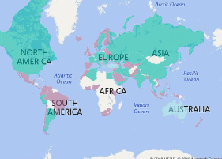
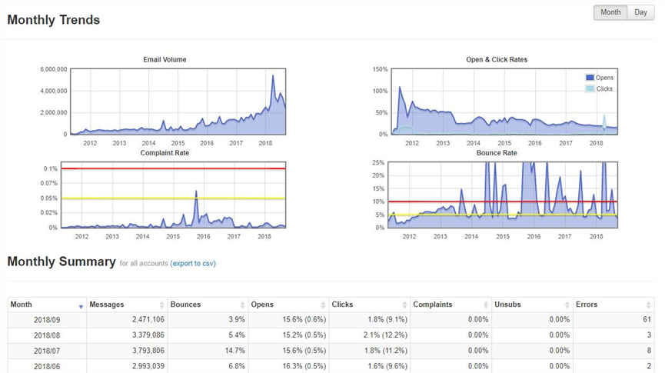
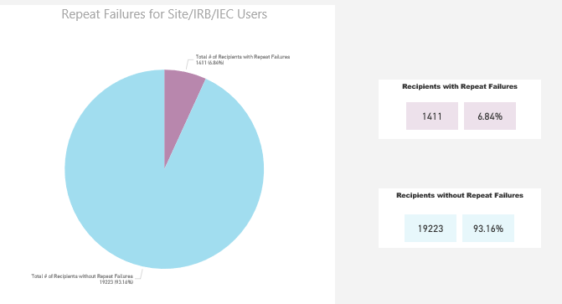
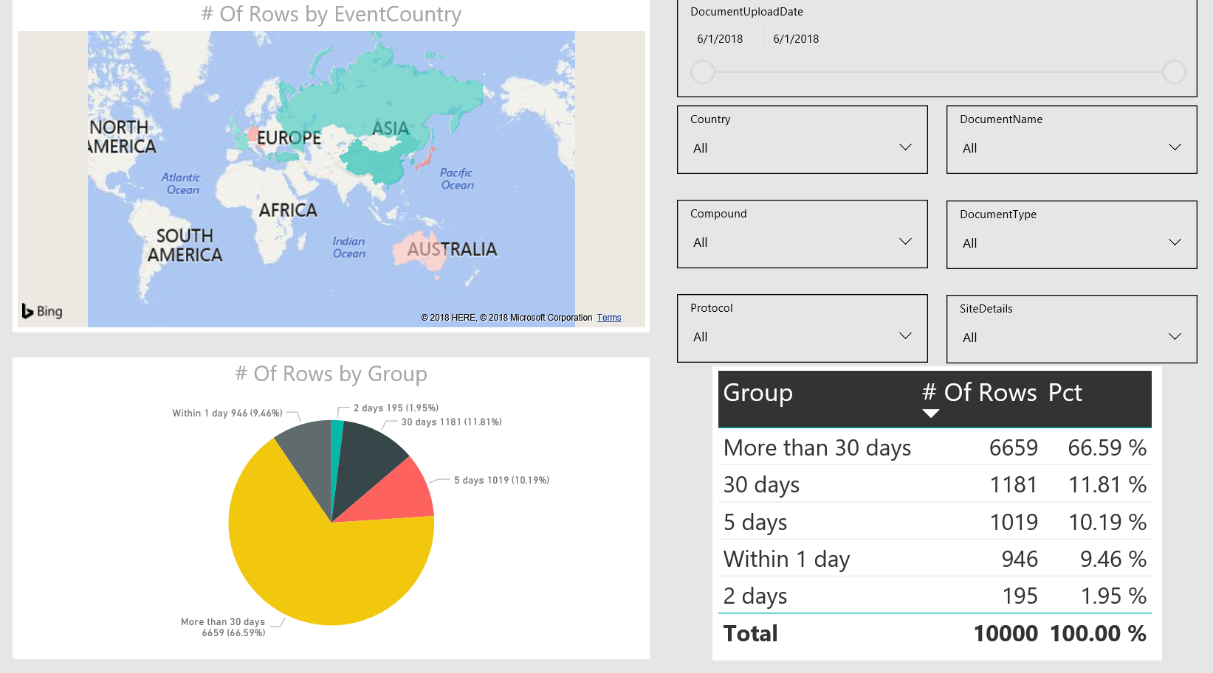
Safety Reporting Quality & Compliance
Country Rules and Amendments
Volume and target audience
Identify risk
How is the information being consumed?
Notes:
What is our suggested solution to end to end safety reporting quality oversight and compliance?
Our working group sponsors have built dashboards that focus on what we can monitor and act upon.
Monitoring regulatory environment with our working group’s input for changes in country rules and regulations
Identifying risk by ensuring all sites follow training and safety requirements
Monitoring the transmission of safety alerts and ensuring that any email bounce backs are routed directly to the responsible person so they can be fixed in accordance with regulatory timelines.

Slide 20

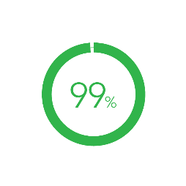
Reduction in Operational Burden
Costs
Avoided
Sites in Compliance
Reduction in Site Burden
150 - 450k
per trial
5-10 hours
per week
Notes:
For the average phase 2 clinical trial, savings have ranged between $150k and $450k per trial.
Average reduction in Safety Reports per Site has been 5 safety letters per week or 5-10 hours per week
99% of sites have trained active users in system receiving delivery.

Slide 21
Benefits of Right-Sizing Safety Reporting
Improve Patient Safety
Make Sites Happier
Pass Inspections
Avoid Costs
Notes:
In summary, by transforming their approach to Global Safety Reporting operations, including global harmonization of the process, precision distribution according to local laws, global quality and regulatory oversight, a sponsor may
improve patient safety
reduce site and operational burden
bullet-proof compliance
avoid unnecessary costs.

Slide 22

Time For Action
Notes:
Change is never painful, only resistance to change is painful.
Please join with us and help us to build the safety reporting reference model.
May all our future global safety reporting be precise and according to local law.

Slide 23




Ask Big Questions
Notes:
Thank you for listening.

Slide 24
Thank You
Steven Beales
SVP, Scientific and Regulatory
WCG Clinical
@stevenbeales
sbeales@wcgclinical.com

